Slide 1
The Big Mountain Ski Resort - Data analysis
Do We Have The Right Ticket Prices?

Slide 2
Problem Identification
Can we increase the weekend ticket prices by 20% to increase the revenue by the next quarter?

Slide 3
Problem Identification
Can we increase the weekend ticket prices by 20% to increase the revenue by the next quarter?
Why do we want to increase the ticket prices?

Slide 4
Problem Identification
Can we increase the weekend ticket prices by 20% to increase the revenue by the next quarter?
Why do we want to increase the ticket prices?
Ticket prices are set based on the market average - currently $81
We might be undervaluing our facilities
Increased operational costs

Slide 5
Recommendation and key findings
Weekend ticket prices can be increased by $3 (considering mean absolute error)
Increasing the vertical drop and adding a chair lift supports an additional ticket price hike of $2
Closing one run will not have an impact on the revenue or ticket price but closing more than 2 runs will cause a revenue drop
Increasing the snow terrain does not support a price hike

Slide 6
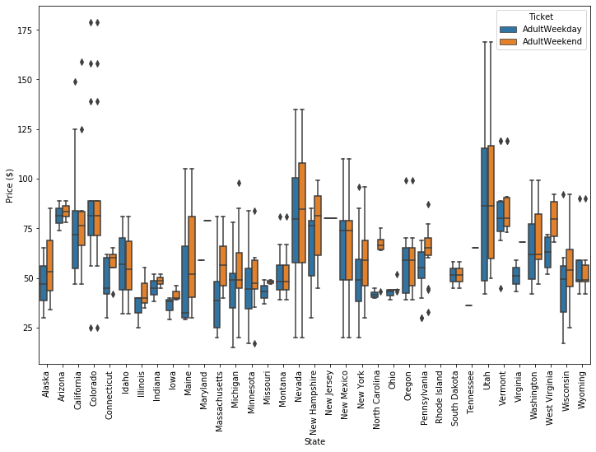
Modeling results and analysis
Typical ticket prices range between $25 and $100. Mostly weekday and weekend prices are similar.

Slide 7
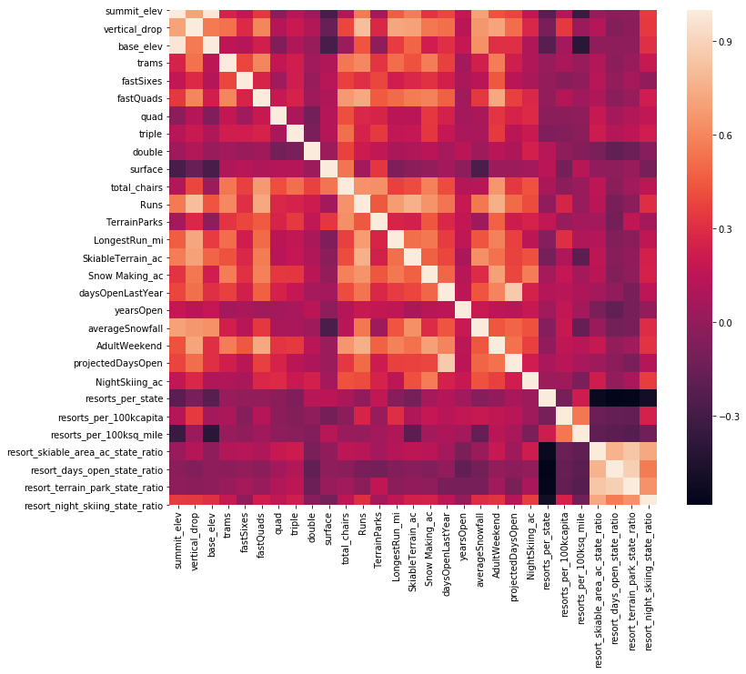
Modeling results and analysis
Correlation between features

Slide 8
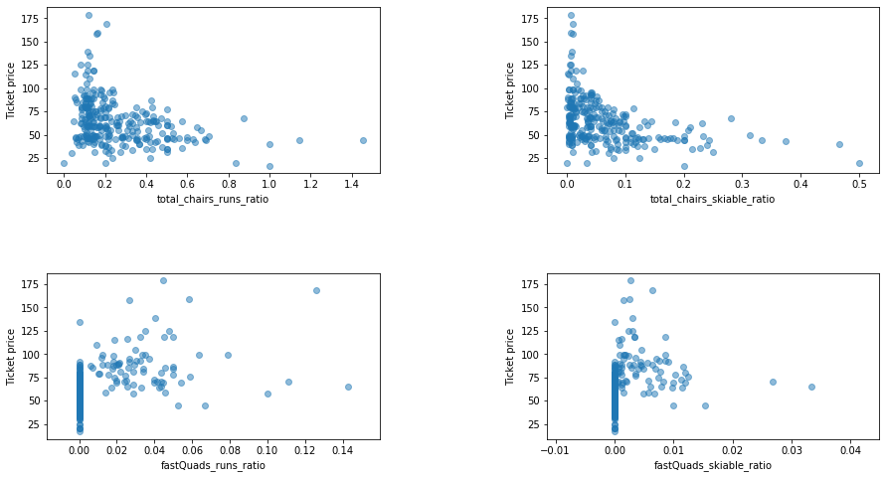
Modeling results and analysis
Important features vs ticket price

Slide 9
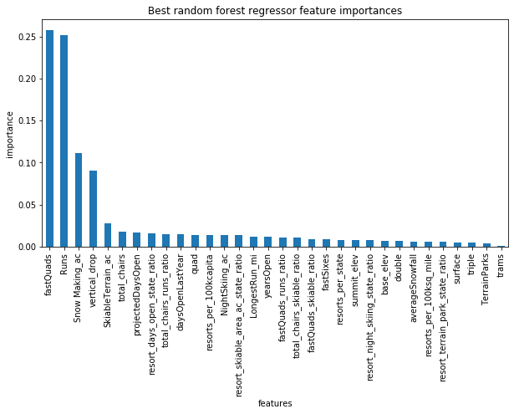
Modeling results and analysis
Most important features
Random Forest Regressor had better statistical markers than linear regression or the baseline model (predicting average price).

Slide 10
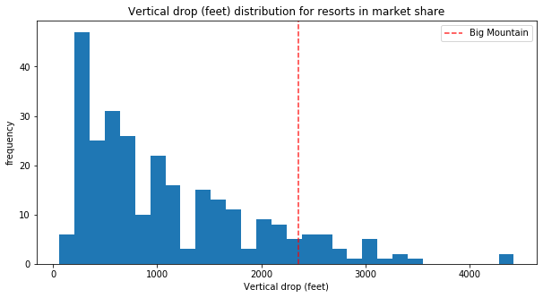
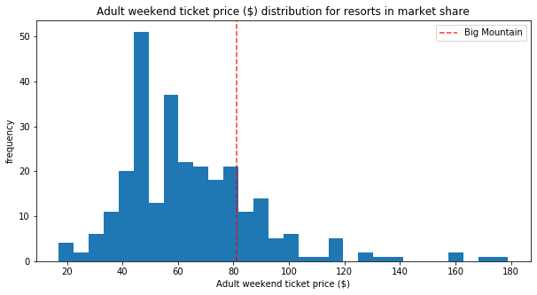
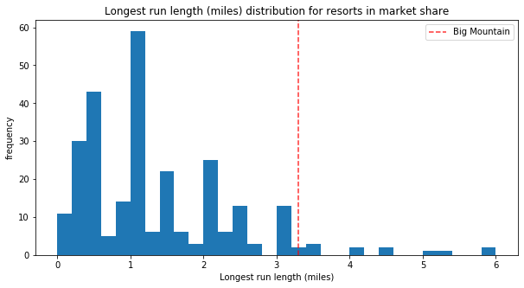
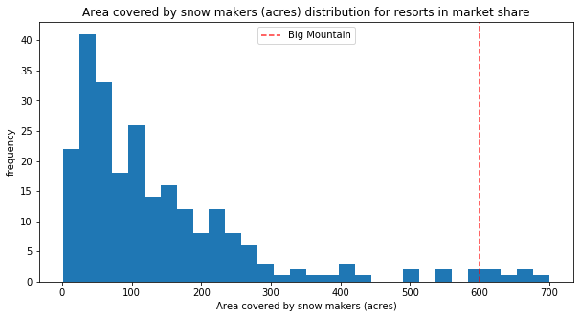
Modeling results and analysis
Our resort is on the higher end!

Slide 11
Summary and conclusion
Random Forest regressor was used to model the problem
Target feature was adult weekend ticket price
The resort is among the largest snowmaking areas with the total number of chairs, fast quads, number of runs, the longest run, and skiable terrain
The vertical drop, total number of chairs, fast quads, number of runs, the longest run, and skiable terrain are the most important features that impact the price of a ticket
The analysis supports a price hike about 3% not 20%
Increasing the vertical drop and adding a chair lift supports a price hike of $2

Slide 12
Thank you!

